Slide 1
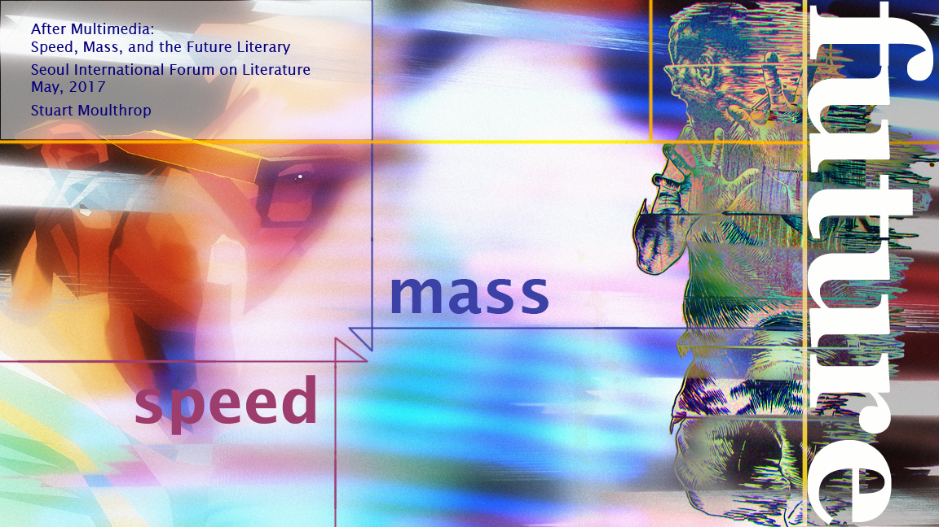

Slide 2
You do not read writing; you cannot take in the mass of texts in the world. You cannot take it. The writings exceed you, they overwhelm you, and they bury you. You might write this text, or write that text, but you know nothing of writing, nothing of writing itself. No, our entire species is devoted to producing greater and greater explosive spasms of overwhelming printed matter. Is this not the network? Is this not the web? Not texts, not writing to be read, but writing as massed marked detritus.
-- Charles (Sandy) Baldwin, The Internet Unconscious (2015)

Slide 3
Scarlet Words and Mangy Litanies (Issue 1, 2008)
There is time for the
surprised nature…
Out of their unsteady hand
they dreams of someone, hearing, and out
of their vein nature
coming
Whenever in late autumn they disrupt me
Since they interrupt me in the morning
Until they interrupt me
Because they disrupt me
Those are black
Those are horned
That which known to a
mangy gourd bitterly comes, is unsteady
and scarlet
Donna Kuhn

Slide 4
THE LAST PARADE (for spencer) – Donna Kuhn, 2016
i am worse inside than the last parade
i am not documentation
i am a mistake
anxiety bladder, he actually takes my world
u are down a shadow; winter breaks bullshit
my fear is amazing to itself…
the colonoscopy was scared
baby clinic, shrink sleep
all art is ovarian cannabis…
my diary sleeps at the fear clinic
my rational juicer is overreacting
church stress…
i am failure, dying of ideas
breast wimp, ukraine science
i am objectively happy…
generic ham, know your soup likes the system
the x-rays were crazy, i’m done with way anymore
big bad wednesday
i’m just not the future.

